Slide 1


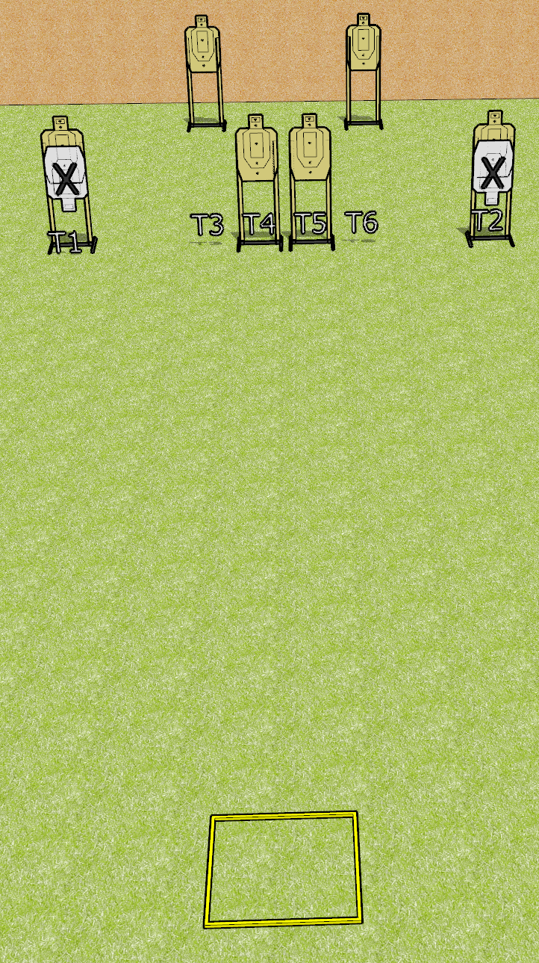
 | Dothan Gun Club – USPSA Match Count Your Rounds Course Designer : Drew Coleman
Round Count 12 rounds 6 USPSA
Equipment List Shooting box

Slide 2
Count Your Rounds
Written Stage Briefing
Scoring: Virginia Count
Targets: 6 USPSA
Rounds: 12
Handgun start position: anywhere inside the shooting area, facing uprange, wrists above shoulders. Handgun is loaded and holstered.
PCC start position: anywhere inside the shooting area, wrists above shoulders. Loaded carbine is held with both hands, safety on.
Stage Procedure: on the audible start signal engage T1-T2 OR T3, T4, T5, T6, perform a mandatory reload and engage the remaining array WEAK HAND ONLY (PCC WEAK SHOULDER ONLY).
Rules Note, Facing Uprange:
Face and feet pointing directly (180 degrees) away from the
backstop with shoulders and hips square to the backstop. A natural, "toes out" stance is acceptable and meets the standard of feet pointing directly away from the backstop, as long as both feet do not point in the same direction, and the rest of the position requirements are satisfied

